Slide 1
Building Enterprise Java Applications with Spring
Day 2
Magdalene Lim,
Desmond Lee,
Kavitha Muniraj
Republic Polytechnic

Slide 2
Welcome and admin matters
Please ensure that:
Attendance has been captured (via QR code scanning)
A learning laptop is with you
Good view on the display
Course materials are also available at: https://github.com/kavithamuniraj/CETSpringBootAY2022
Notes:
https://en.wikipedia.org/wiki/QR_code_payment

Slide 3
Admin matters
A tidy/clean laptop is a good laptop for learning
Files created on the laptop will linger on. To prevent this:
Create a folder in the "Documents" location for this workshop
E.g. “SpringBoot-Alan" or “SpringBoot-PeterPan“
All user created files to be placed in this folder
Delete that folder after the course
Notes:
https://en.wikipedia.org/wiki/QR_code_payment

Slide 4



Trainers
Magdalene Lim
Senior Lecturer
School of Infocomm
Magdalene_lim@rp.edu.sg
Desmond Lee
Associate Lecturer
School of Infocomm
DESMOND_LEE@myrp.edu.sg
Kavitha Muniraj
Lecturer
School of Infocomm
Kavitha_muniraj2@rp.edu.sg
Notes:
https://en.wikipedia.org/wiki/QR_code_payment

Slide 5
Schedule
Time | Agenda
9:00 am - 9:15 am | Welcome and admin matters
9:15 am – 10:30 am | Styling a Webpage - Bootstrap Navigation Bar
10:30 am – 10:45 am | Break
10:45 am – 12:30 pm | Spring boot application accessing the Database – MYSQL DB and MYSQL setup Create Model to map to the DB
12:30 pm – 1:30 pm | Lunch
1:30 pm – 3:15 pm | Accessing the DB – Category Controller and Repository
3:15 pm – 3:30 pm | Break
3:30 pm – 4:45 pm | Item Controller and Repository
4:45 pm – 5:00 pm | Wrap up, Q&A
Notes:
https://en.wikipedia.org/wiki/QR_code_payment

Slide 6
Topics Covered in this course
Using Bootstrap to style a webpage
Create Model and map to Database
CRUD using MYSQL
Notes:
https://en.wikipedia.org/wiki/QR_code_payment

Slide 7

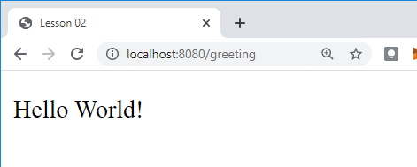
RECAL - REST API – Client Server Model
1. The client makes a request
http://localhost:8080/greeting
2. The web server receives the request and passes it to the controller.
3. GreetingController.java processes request and returns response (View)
greeting.html
(View)
4. The client displays the response received.
Notes:
What web server are we using?

Slide 8
Styling a web page

Slide 9

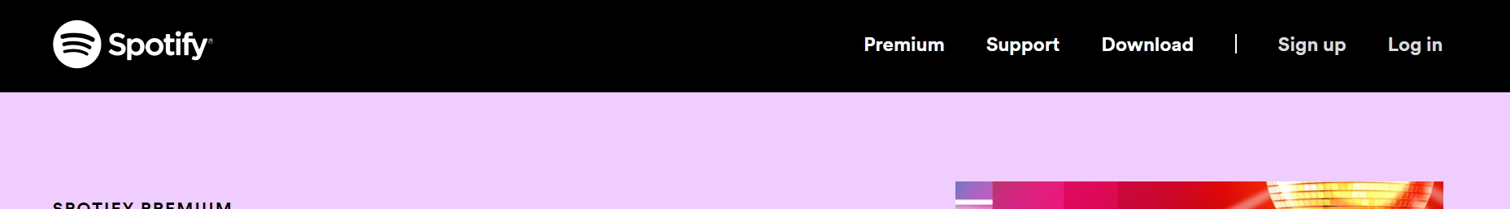
Header and navigation
The website header refers to the top section of the web page that will usually contain branding information such as the logo, company name, tag line, etc.
The header may also include the navigation links of the website, search bar, etc.

Slide 10
Bootstrap - Navigation
Bootstrap provides support for responsive navigation headers, branding and more, in the form of the navbar.
We apply the navbar/navbar related classes in the nav HTML element.
Notes:
Bootstrap 5 (beta)
Bootstrap 5 also has a flexbox Navbar, and introduces new RTL support. For this reason the concept of "left" and "right" has been replaced with "start" and "end". Therefore the margin utilities changed for Bootstrap 5 beta:
ml-auto => ms-auto
mr-auto => me-auto
Also note that data-toggle and data-target have changed too:
data-toggle => data-bs-toggle
data-target => data-bs-target
https://stackoverflow.com/questions/19733447/bootstrap-navbar-with-left-center-or-right-aligned-items

Slide 11
Exercise 1 – Navigation
Go to: https://codepen.io/magdalene-lim/pen/powQaGw
Make the following modifications one by one and observe the changes in the display panel. The first one is done for you.
Modifications | Observations
Change bg-light to bg-dark | The background of the navigation area will change to a dark grey.
Change navbar-light to navbar-dark
Remove navbar-expand-lg
Remove me-auto
Remove the second nav-link
Notes:
This exercise is to encourage and show students how to test out the classes available as there is too much to cover in Bootstrap.
Encourage students to explore further on their own.

Slide 12
Exercise 1 – Navigation
Go to: https://codepen.io/magdalene-lim/pen/powQaGw
Make the following modifications one by one and observe the changes in the display panel.
Modifications | Observations
Change bg-light to bg-dark | The background of the navigation area will change to a dark grey.
Change navbar-light to navbar-dark | The navigation text will change to a lighter colour.
Remove navbar-expand-lg | This navigation links will be in a vertical column
Remove me-auto | The navigation links will be aligned to the right.
Remove the second nav-link | The style of the link will be the standard blue text.

Slide 13

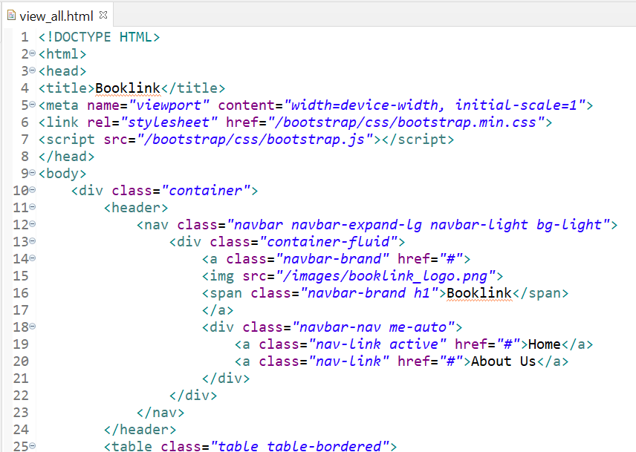
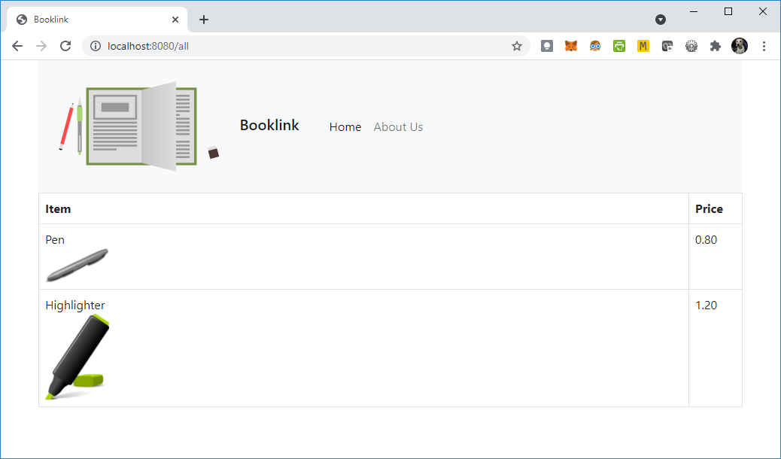
Exercise 2 - Header
Modify view_all.html to include a header element
In the header element, create the nav element.
The nav element should include the Booklink logo, company name, and 2 navigation links as shown.
Create about_us.html and link it to the Navigation Bar

Slide 14
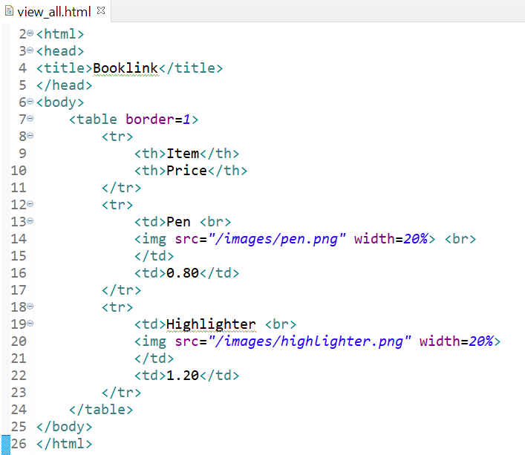
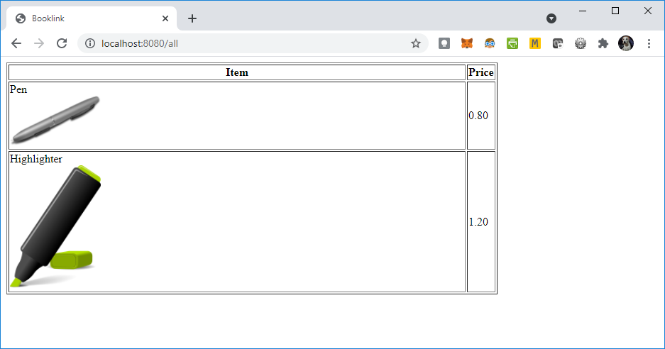
Exercise 2 – Book link Images
Modify view_all.html as shown in the code
The paths shown here under the src attribute is a relative path. In this case, the image paths are relative to the location of the current project.
Relative paths ensure that even if you move the project, for example to the cloud, your links to the images will still work.
If we had used the absolute path of where we stored the image files(which is the full path starting from C:/ or D:/ ), moving the project to cloud will break the links and the images will not be displayed.
Notes:
Show students the location path of the image on laptop.
Students have uploaded html files and images to aws in the previous module, C369

Slide 15

BREAK

Slide 16
Spring Boot Application accessing the Database
Notes:
Similar to lesson 02 instructions

Slide 17
Recall MVC →3-Tier Web Architecture
To create applications that can perform transactions (e.g. ticketing, e-commerce, etc), we need to have a way to store data.
In the 3-tier model, we include the database to help us store data.
Booklink e-store
Presentation Tier
User Interface(UI) to be displayed on the client(e.g. web browser)
Logic Tier
Business rules, processes, routing
Data Tier
Data storage in a database(e.g. MySQL)

Slide 18
Recall MVC (Model, View, Controller)
Looking from the MVC perspective
Model
(Data structure)
Provides the data to be displayed
Manipulates the model
View
(User interface)
Sends request
Controller
(Control logic)
Returns a response

Slide 19
Model-View-Controller
The model represents the data and data logic
In Java, we can create classes such as Car, Watch, Employee, etc.
We can also refer to these as Plain Old Java Objects or POJO.
A POJO can be used as a model, which can then be mapped to the data in the database.
Notes:
In the previous lesson, we discussed about how to use and create the views and the controllers. Today we will discuss about the Model.

Slide 20
Springboot with MySQL
Today we will require the use of
MySQL Community Server
MySQL Workbench
Notes:
In C207, students used MySQL

Slide 21
Springboot with MySQL
In order to access the database with Springboot, we will be including the following dependencies for today’s project:
Spring Boot DevTools
Spring Web
Thymeleaf
Spring Data JPA*
MySQL Driver*
*The additional dependencies are for connecting to the database and using JPA
Notes:
In C207, students used MySQL

Slide 22
Exercise 3 – Create L02 project
Create a new springboot project named LP02.
Note that we will need the following dependencies
Spring Boot DevTools
Spring Web
Thymeleaf
Spring Data JPA
MySQL Driver
Refer to Springboot_Project_Setup_Guide.pptx in Day 1 resources for details on setting up the springboot project.

Slide 23
Exercise 3 – Prepare and start MySQL
Start MySQL server if it is not yet started.
Refer to Starting MySQL Server for Windows 10.docx if you are unsure how to start MySQL server.
Start up MySQL Workbench
Create a database schema named cet
Notes:
Lecturer may need to guide students if they have forgotten how to start their server or create a database.

Slide 24
Exercise 3 – Setup Spring Boot app Database MYSQL properties
Open application.properties
Copy and paste the configurations below into application.properties
spring.datasource.url=jdbc:mysql://${MYSQL_HOST:localhost}:3306/cet?serverTimezone=UTC
spring.datasource.username=root
spring.datasource.password=spring
spring.jpa.hibernate.ddl-auto=update
spring.jpa.show-sql=true
spring.jpa.properties.hibernate.format_sql=true
Note that in production systems, we should create a different username and password.
Notes:
Students should use their own db username and password if they have changed it.

Slide 25
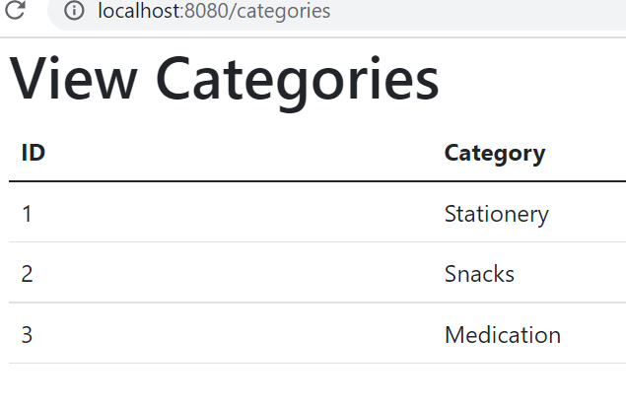
Viewing a list of categories
To capture category inventory, we will create the model, view and controller that allows us to view all categories

Slide 26
Viewing a list of categories
We will be creating the following:
Model: Category.java
View: view_categories.html
Controller: CategoryController.java
In addition, to allow easy access to the database, we will create a repository interface to help with CRUD (Create, read, update and delete) operations
Repository: CategoryRepository.java
What is CRUD?

Slide 27
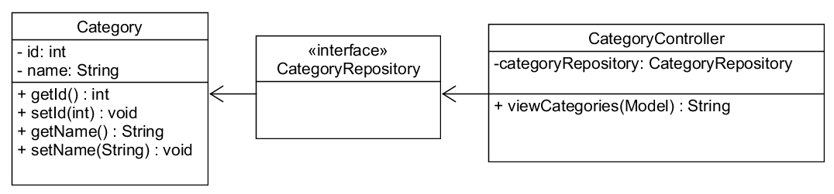
What is an interface?
Notes:
An interface is a completely "abstract class" that is used to group related methods with empty bodies

Slide 28
Model

Slide 29
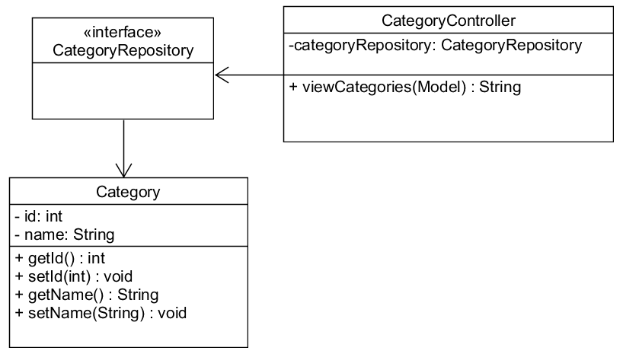
Category Model
The class diagram shows a POJO,
By using some annotations, we can enable the Category class to map to the database.

Slide 30
Category Model
To create a model that will map to the database, we need to follow the steps below:
Create the POJO based on the class diagram.
Add the @Entity annotation before the class declaration.
Add the @Id and @GeneratedValue annotation just before the field that is meant to be the primary key.

Slide 31
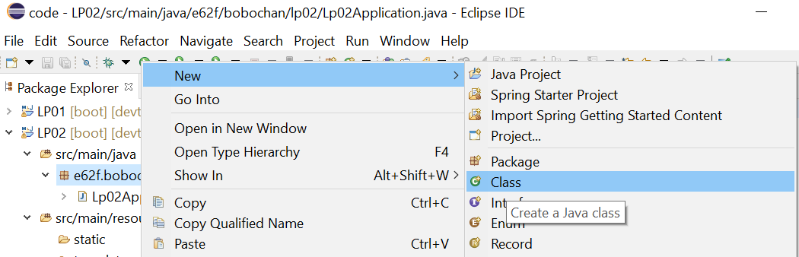
Exercise 4 – Creating Category Model
Right-click on the project package under src/main/java
Select New > Class

Slide 32
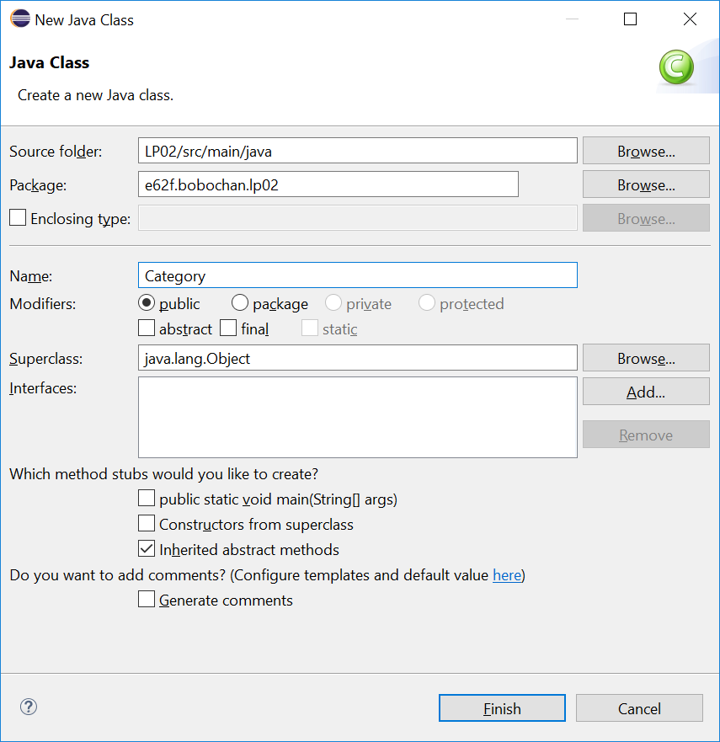
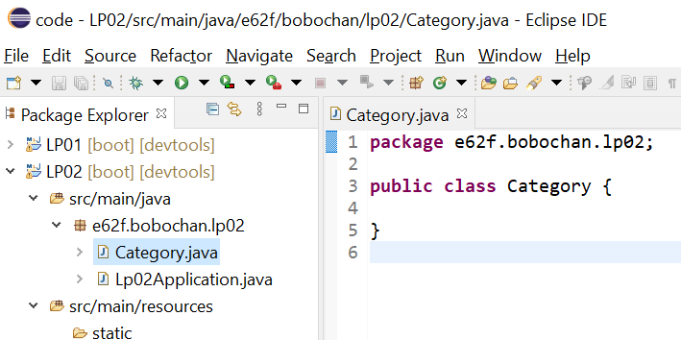
Exercise 4 – Creating Category Model
Name the class Category
Click Finish
You should see Category.java as shown

Slide 33
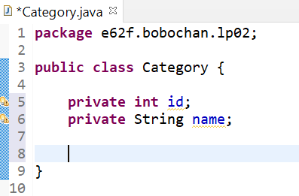
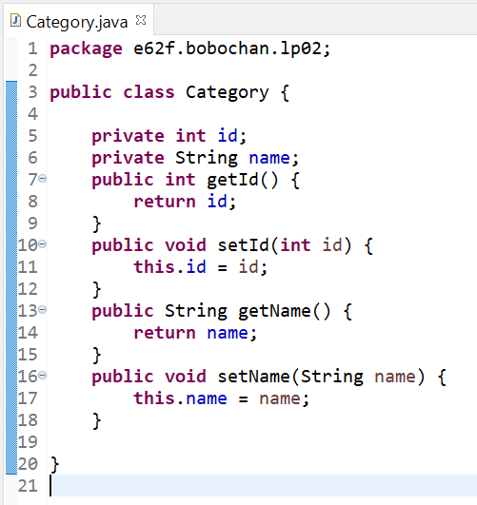
Exercise 4 – Creating Category Model
Modify the Category class to include the id and name as shown
Right-click in the empty space below the fields
Select Source > Generate Getters and Setters…
Click Select All and Generate
The getters and setters will be generated for you
What happens if we do not create a constructor?
Notes:
They have learnt how to generate getters and setters as well as constructors in C208
If we do not create the constructor, Java will use the default constructor which is just an empty constructor(Recall in C208)

Slide 34
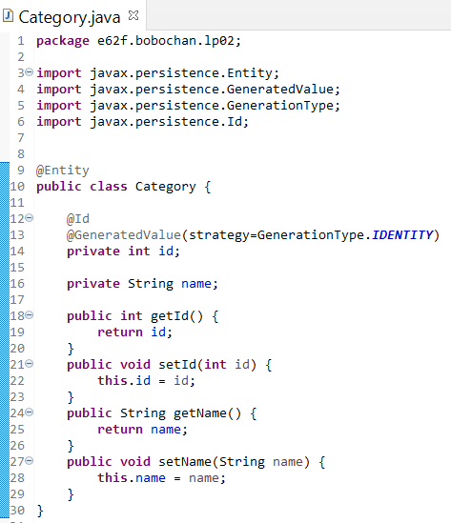
Exercise 4 – Creating Category Model
Add @Entity just before public class Category..
Add @Id and @GeneratedValue(strategy=GenerationType.IDENTITY) just before the fields
The annotations will have a red line below them, remember to import the required libraries.
The @Id and @GeneratedValue annotations directly before a field indicates that the field(in this case, id) is the primary key

Slide 35
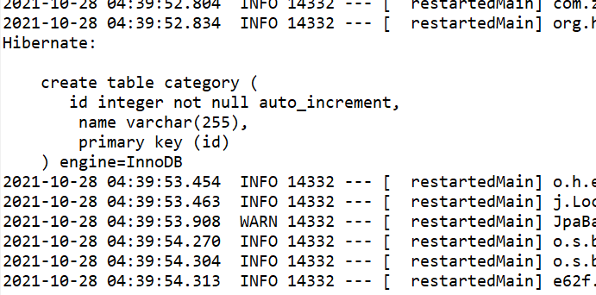
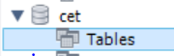
Exercise 4 – Creating Category Model
Execute LP02Application.java
Observe the output in the console
Go to MySQL workbench and refresh the cet database that you created earlier.

Slide 36
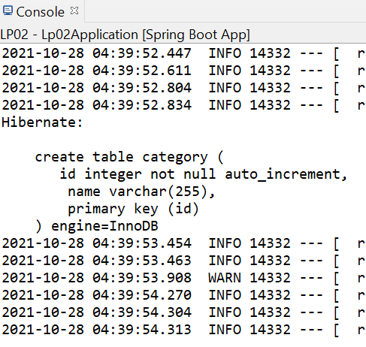
Model - How it works
@Entity specifies that this class maps to a database table
@Id specifies that the field just below it is the primary key.
@GeneratedValue specifies how the primary key is generated.
In this case, using IDENTITY, the primary key will auto increment.

Slide 37
Exercise 5 – Model and DB
After creating the Category model and running the project:
Describe what happened to the database when LP02Application.java was executed.
In the console, the “create table category…” statement was shown. Which file and what configuration is used to display this information?

Slide 38
Exercise 5 – Model and DB
After creating the Category model and running the project:
Describe what happened to the database when LP02Application.java was executed.
When LP02Application was executed,
Springboot scans the project for components.
Since Category.java is tagged with @Entity,
Springboot proceeds to map Category class to the database.
The category table was created in the cet database based on the Category model.

Slide 39
Exercise 5 – Model and DB
After creating the Category model and running the project:
In the console, the “create table category…” statement was shown. Which file and what configuration is used to display this information?
The file is application.properties. The settings in application.properties help to configure springboot so that springboot knows where is the database located, login details, as well as how to handle entities.
We can also configure whether springboot should display the SQL statements executed.
The configuration to display SQL is spring.jpa.show-sql=true

Slide 40

LUNCH

Slide 41
Accessing the DataBase – Repository and Controller

Slide 42
Classes Overview
In addition to controllers, to help us easily work with data from the database, we make use of the JpaRepository interface
CategoryRepository interface will extend the JpaRepository interface.
The JpaRepository will provide methods such as findAll, findById, save, delete, etc.
https://docs.spring.io/spring-data/jpa/docs/current/api/org/springframework/data/jpa/repository/JpaRepository.html
Notes:
An interface is a completely "abstract class" that is used to group related methods with empty bodies

Slide 43
Spring Data JPA (Java Persistence API)
Spring Data JPA aims to significantly improve the implementation of data access layers by reducing the effort to the amount that’s needed.
Implementing a data access layer of an application can be cumbersome as too much boilerplate code has to be written to execute simple queries.
As a developer, you create repository interfaces, including custom finder methods, and Spring will provide the implementation automatically.
https://spring.io/projects/spring-data-jpa
Notes:
https://spring.io/projects/spring-data-jpa

Slide 44
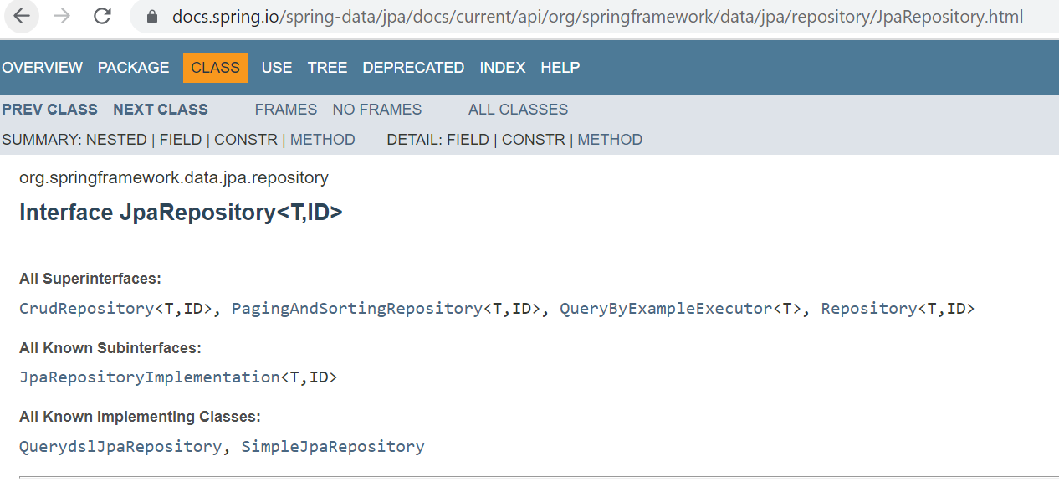
Java Persistence API
The Java Persistence API (JPA) is a specification for object-relational mapping in Java
JPA allows us to save and load Java objects without writing SQL.
We can simply extend the JpaRepository Interface and Spring Data JPA will create the implementation when the application is run.
Notes:
Students have covered interfaces in C209

Slide 45

Hibernate
Hibernate is an implementation of the Java Persistence API (JPA) specification.
It is an Object/Relational Mapping(ORM) framework which allows the mapping of Java classes to database tables.
This saves us time as we can perform CRUD operations without writing SQL code.
This is implemented through the use of Java annotations (e.g. @Entity)
Notes:
https://hibernate.org/orm/what-is-an-orm/

Slide 46
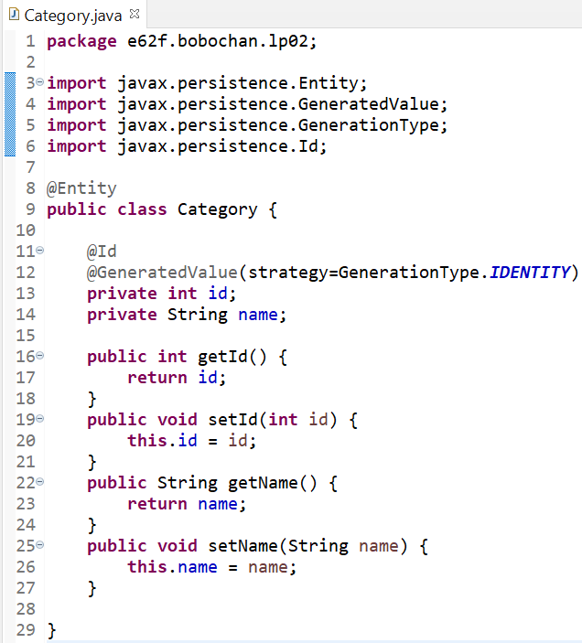
JPA-Hibernate-MySQL
Springboot application
Spring Data JPA
Hibernate ORM Framework
MySQL DB

Slide 47
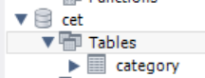
Exercise 6 – Preparing sample data
In order to extract data from the database to view on a webpage, we will need to insert some data first since we have not yet created the add feature.
Some sample data in categories.sql has been provided to you.
Execute categories.sql in MySQL workbench to import the sample data.
Recall that the category table has already been created earlier after executing the springboot project, so categories.sql will only contain insert statements.
Notes:
Lecturer to check that students have import the data correctly.

Slide 48
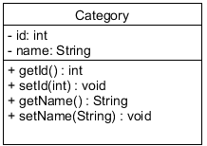
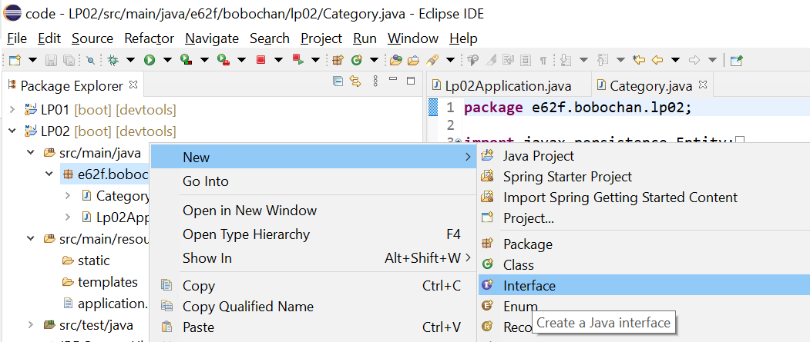
Exercise 7 – Creating CategoryRepository
Next we will need to create CategoryRepository
Right-click on the package under src/main/java
Select New > Interface

Slide 49
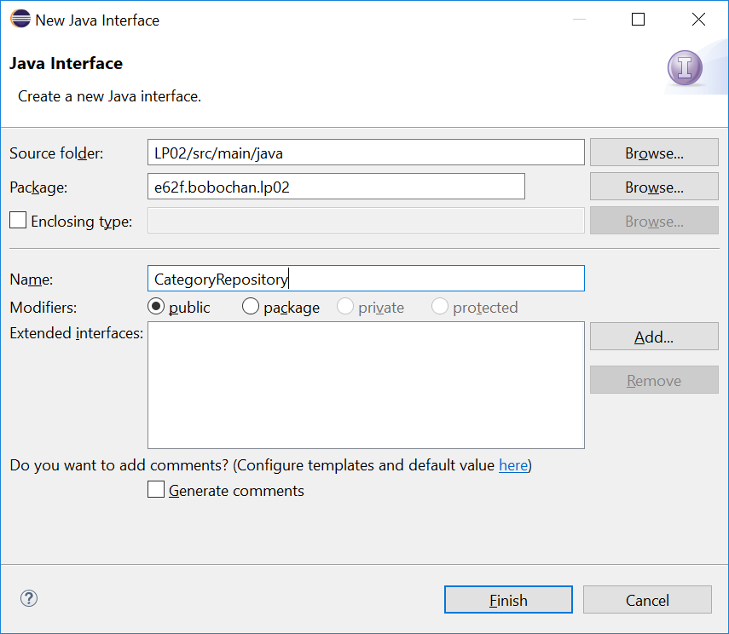
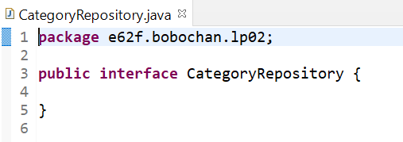
Exercise 7 – Creating CategoryRepository
Name the interface CategoryRepository
Click Finish
The interface should be created as shown

Slide 50
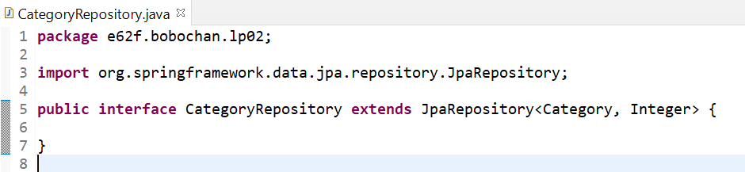
Exercise 7 – Creating CategoryRepository
In CategoryRepository, extend the JpaRepository as shown
You will need to import the JpaRepository library

Slide 51
Exercise 8 – Creating CategoryController
Right-click on the package under src/main/java
Select New > Class
Name the class CategoryController and click OK

Slide 52
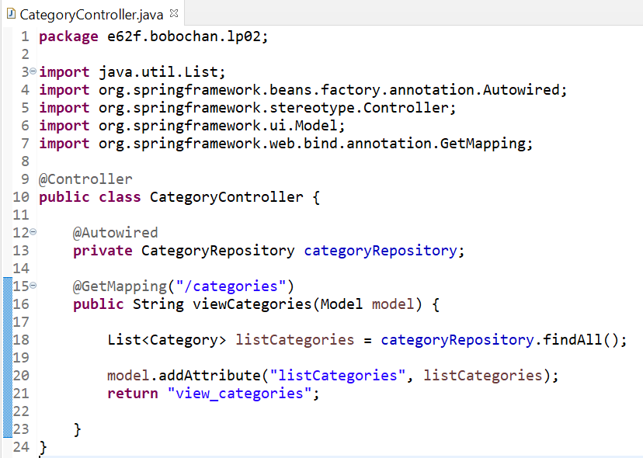
Exercise 8 – Select * Query → findAll()
Modify CategoryController as shown
Paste your code for CategoryController.java

Slide 53
Accessing the DataBase - How it works
3. Category used by JPA repository as the type, and Integer as the ID
2. Because CategoryRepository extends JpaRepository, we can use the pre-defined methods already implemented by JpaRepository.
In this case, the findAll method will help to find all categories and store them as a List of Category objects in listCategories.
1. When an object reference has @Autowired annotation, it tells Springboot to look for a class that matches, in this case the CategoryRepository
4. List is an interface as well. The ArrayList implements the List interface.
5. listCategories is added to model, making it accessible to the view, view_categories.

Slide 54
Exercise 9 – Mappings to the view
In CategoryController,
What would be the URL that would map to the @GetMapping(“/categories”)?
What would be the filename of the view template used?

Slide 55
Exercise 9 – Mappings to the view
In CategoryController,
What would be the URL that would map to the @GetMapping(“/categories”)?
http://localhost:8080/categories
What would be the filename of the view template used?
view_categories.html

Slide 56
View with Thymeleaf

Slide 57
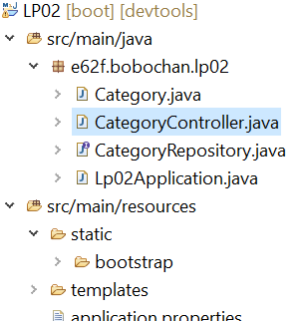
Exercise 10 – Creating category list view
From the resource folder provided in LEO, copy and paste the bootstrap folder into the static folder under src/main/resources

Slide 58
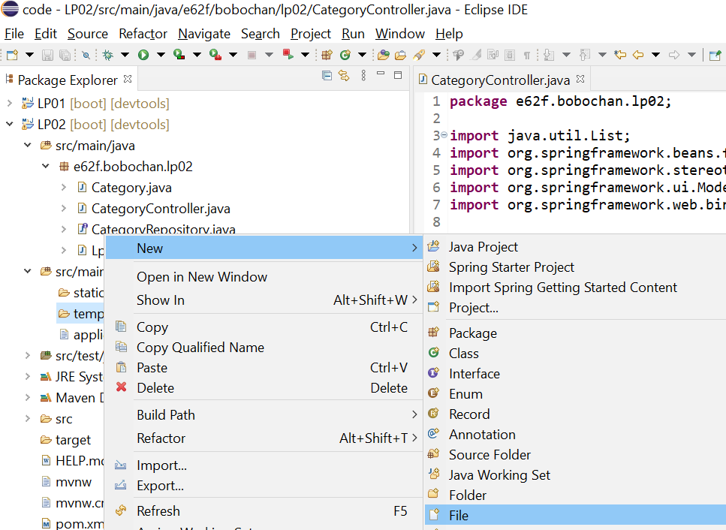
Exercise 10 – Creating category list view
Under src/main/resources, right-click on the templates folder
Select New > File

Slide 59
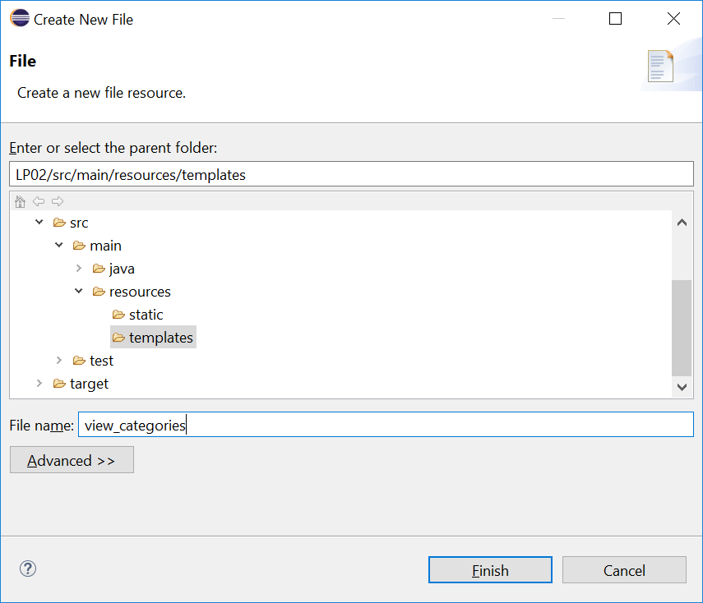
Exercise 10 – Creating category list view
Name the file as view_categories.html
Click Finish

Slide 60
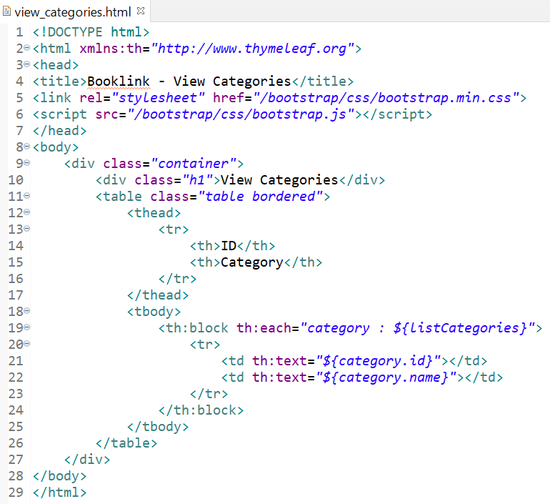
Exercise 10 – Creating category list view
Modify view_categories.html to include the code shown.
Ctrl-Shift-F to format your code
Paste the code for view_categories.html into your worksheet.
Elements or attributes with th: is using the thymeleaf namespace

Slide 61
Exercise 10 – Creating category list view
Execute your project
Go to http://localhost:8080/categories in your browser

Slide 62
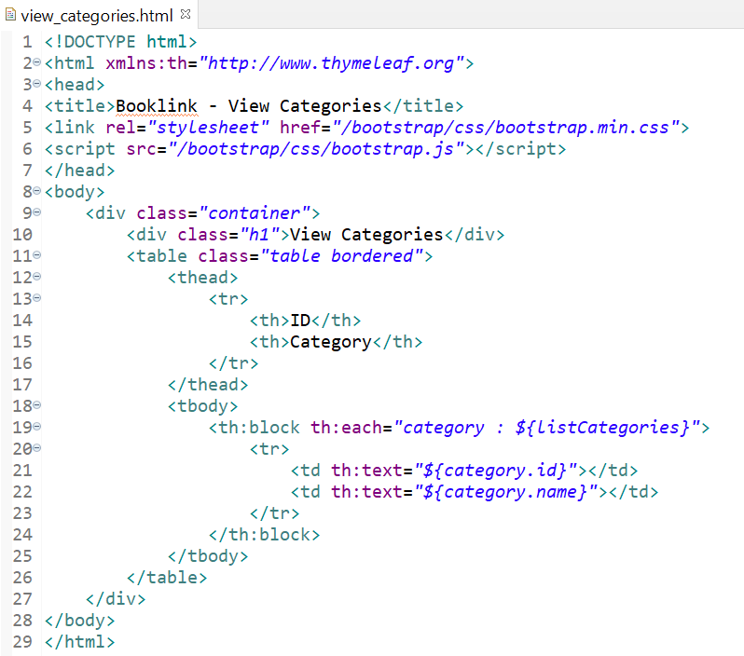
Thymeleaf - How it works
2. listCategories is added to model, making it accessible to the view, view_categories.html.
1. Returning the String “view_categories” will route to view_categories.html
Notes:
Remind students that the “<th></th>” is a html table header element, not to be confused with the thymelead namespace “th”

Slide 63
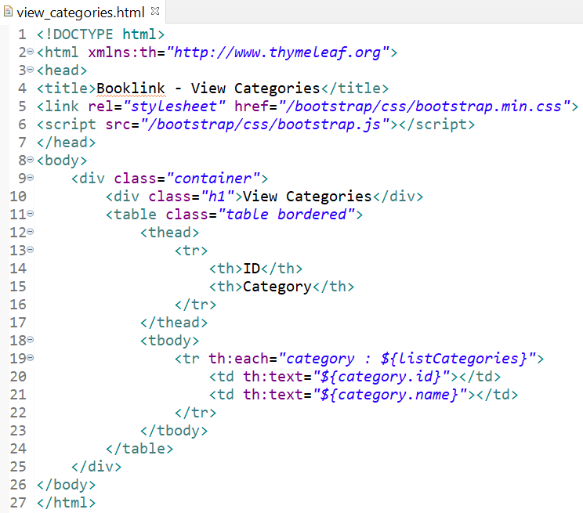
Thymeleaf - How it works
1. Thymeleaf namespace is declared for th:* attributes. Use of Thymeleaf prefix “th” with namespace http://www.thymeleaf.org
Note: Do not mix this up with the <th> element
2. th:each is used to iterate lists. In this case, we are iterating through the list of categories.
Variable expressions ${…} is used to retrieve the information stored in the model attributes. Variable expressions can be set as attribute values or text
In the code here, each category object is taken out of ${listCategories} and the details such as id and name is extracted from the category object using ${category.id} and ${category.name}.
4. th:text will evaluate to the value of the expression (e.g. category id, category name in this view), and display the value in the table cell.
Notes:
Remind students that the “<th></th>” is a html table header element, not to be confused with the thymelead namespace “th”

Slide 64
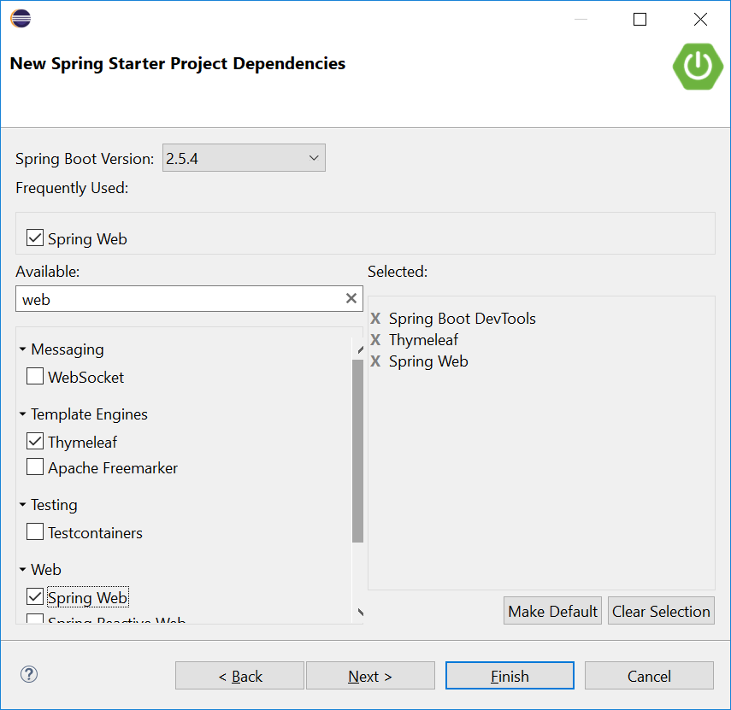
Thymeleaf
Recall that in our Springboot projects, we included a dependency, Thymeleaf.
Thymeleaf is a server-side Java template engine for both web and standalone environments.
It is a view technology that performs server-side rendering of HTML.
We use variable expressions ${…} bind the data from the template context(model) into the resulting html(view).

Slide 65
How it works
Today, we used the variable expression ${…} to retrieve the information stored in the model attributes.

Slide 66
How it works
We used the variable expression ${…} to retrieve the information stored in the model attributes.

Slide 67
Thymeleaf attributes
th:each - used for iteration
th:text - evaluates its variable expression and sets the result of this as the body of the tag it is in
As we progress in the lessons, we will be using more types of attributes. You can find the full list here:
https://www.thymeleaf.org/doc/tutorials/3.0/usingthymeleaf.html#setting-attribute-values

Slide 68
Viewing a list of categories

Slide 69
BREAK

Slide 70
Task: Viewing a list of Items

Slide 71
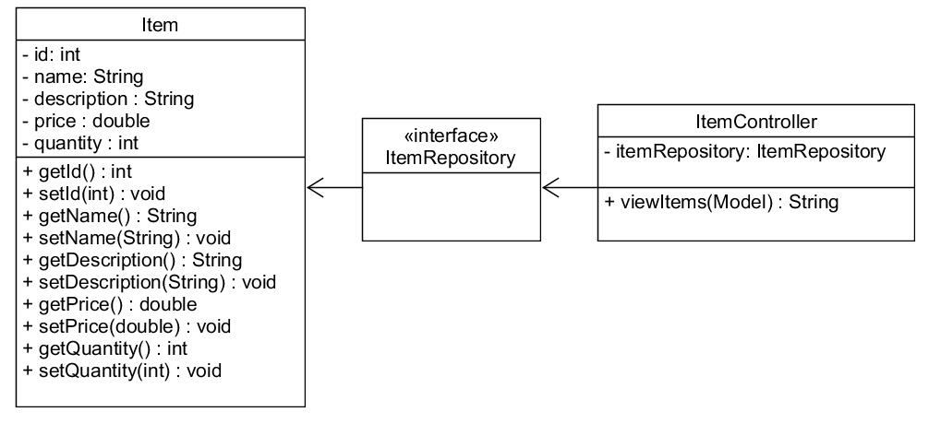
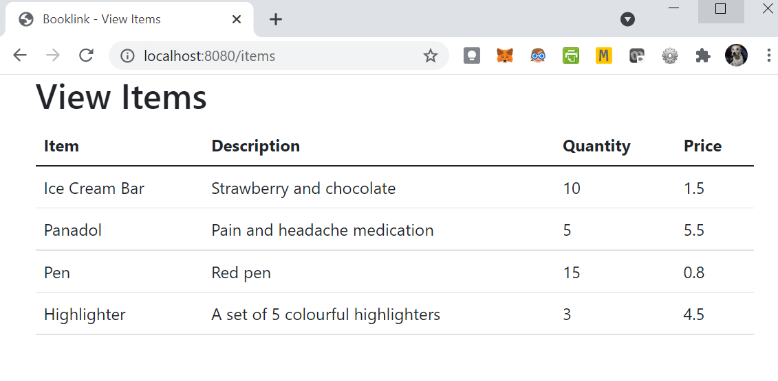
Exercise - Viewing a list of items

Slide 72
Exercise 11 – Viewing a list of items
Study the class diagram shown. In LP02, create the Item Model, Controller and Repository classes required.
Notes:
Students to work through this on their own.

Slide 73
Exercise 11 – Viewing a list of items
Sample data items.sql has been provided to you.
Create a view named view_items.html to display a list of items as shown.

Slide 74
Solution – Viewing a list of items
Study the class diagram shown. In LP02, create the Model, Controller and Repository classes required.

Slide 75
Solution – Viewing a list of items
Sample data items.sql has been provided to you.
Create a view named view_items.html to display a list of items as shown.

Slide 76
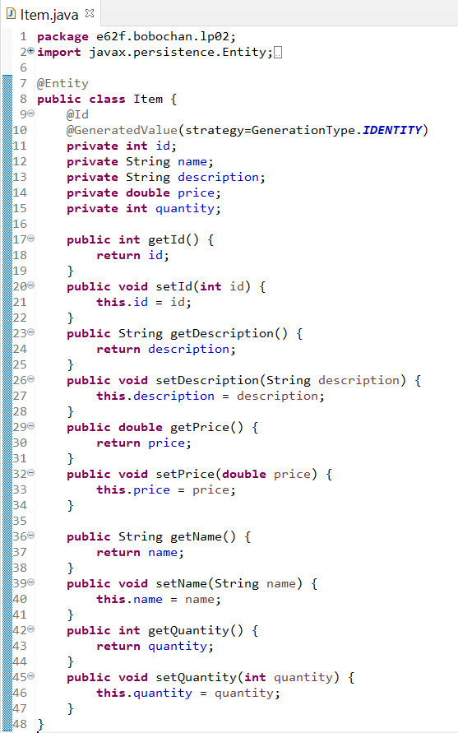
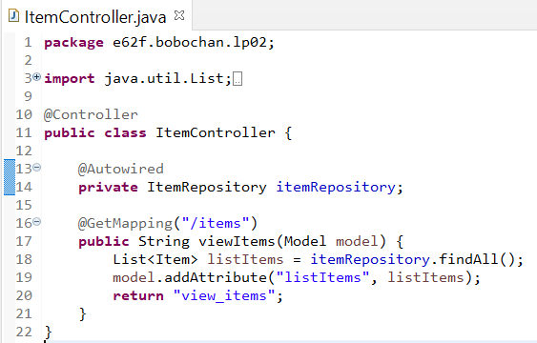
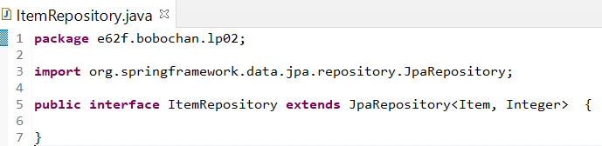
Solution – Viewing a list of items
Notes:
Review how the JpaRepository is used.

Slide 77
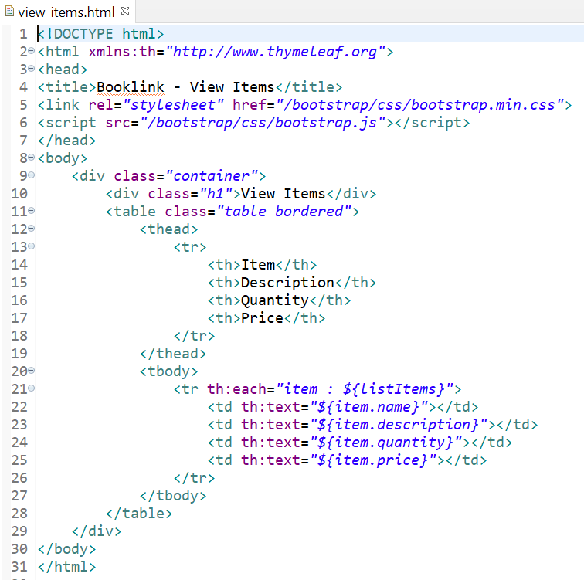
Solution – Viewing a list of items
Notes:
Discuss about the thymeleaf namespace and attributes

Slide 78
Summary
In this lesson, you learnt about:
The Spring Boot application accessing the Database
Model mapping to the Database Table
Java Persistence API – findAll()
Interface Repository that connects the database through JPA and the Hibernate ORM (Object Relational Mapping)
Thymeleaf

Slide 79
Thank you Q&A

